Slide 1
BINDER ORGANIZATION
Ms. MARTIN’s LITERACY CLASS

Slide 2
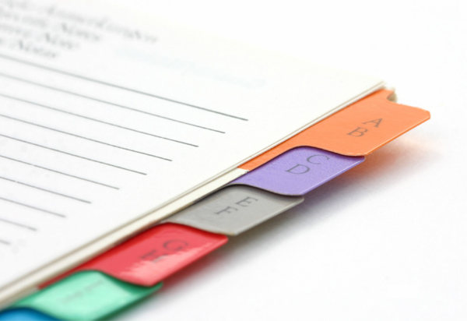
BINDER PURPOSE
Organizational skills!
Building curriculum!
Never lose papers/homework!
No wasted time!
Resource!

Slide 3
BINDER tabs
SECTION #1 → READING
SECTION #2 → WRITING
SECTION #3 → NOTES/RESEARCH
SECTION #4 → VOCABULARY
SECTION #5 → GRAMMAR

Slide 4
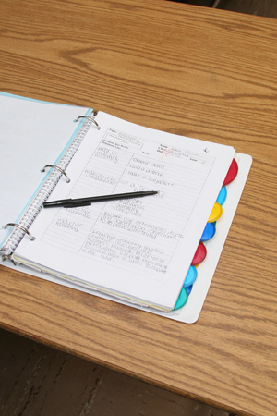
BINDER entry labels
EVERY handout has an entry label!
Binder entry labels written on front board!
Write entry AS SOON AS YOU GET IT!
Place into binder AS SOON AS YOU GET IT!

Slide 5
BINDER TESTS
Requires an organized and up-to-date binder!
2 tests per quarter! (mid / final)
Assesses organization, formative corrections, listening!
Example Questions:
[Reading #10] – What is the answer to number 2?
[Grammar #8] – What is the first word in question 8?

