Slide 1
OPENING PROCEDURE
So we Start Each Day the Right Way!

Slide 2
What is an opening procedure?
Opening Procedure
how you will enter the classroom and begin to focus on Literacy each day

Slide 3
Ummmm, why?
No confusion
No wasted time
No pickpocketed papers

Slide 4
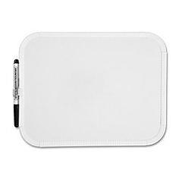
Even before the opening…
MATERIALS!!!!
Bring everything on the board.
No going to get homework after bell.

Slide 5
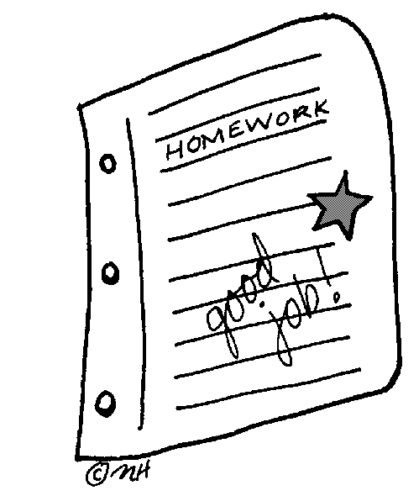
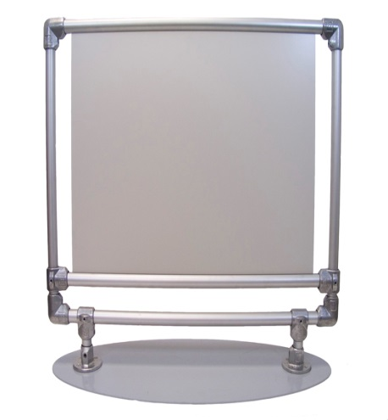
OUR OPENING PROCEDURE
Take your folder from the black box.
Drop off extra goodies in black baskets.
Go to your seat and place yourself in it.
Put homework on your desk.
Look at the overhead and follow the directions for the opening activity.

Slide 6
YOU MUST BE IN YOUR SEAT WORKING ON THE BELL WORK WHEN I SHUT THE DOOR!!!!!
Failure to follow the opening procedure will result in EXTRA PRACTICE!!!!!

Slide 7
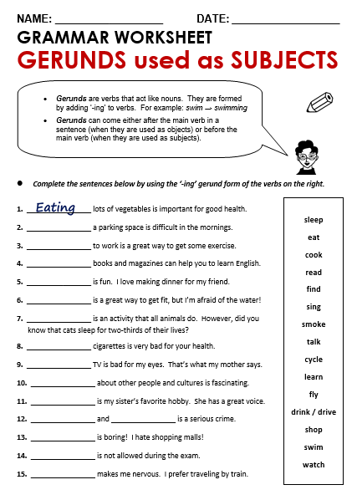
The opening routine for Literacy is coming into the classroom before the bell rings, reading the projector, and starting the daily bell work. This procedure prevents a loss of valuable instructional time and ensures that all students are prepared to start the lesson. As there are five minutes to switch classes, this is a realistic and manageable expectation for all students.
Today, since you did not complete the opening procedure after receiving multiple warnings, you are to complete this extra practice worksheet. This will not only help you more thoroughly master learning standards, but will also help you remember to follow classroom procedure! The completed practice must be given to Ms. Martin tomorrow before 3 p.m. Failure to do so will result in a discipline referral.
Just be in your seat working on the bell work when I shut the door!

Slide 8
CLOSING PROCEDURE
So we END Each Day the Right Way!

Slide 9
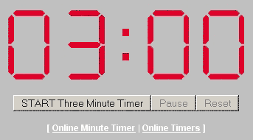
OUR CLOSING PROCEDURE
Take all new materials out of folder.
Put homework and/or classwork in folder.
Put your folder into the black box.
Throw out all trash.
Wait at desk SILENTLY until dismissed.

