Slide 1
ELEMENTS OF A STORY: CHARACTER DEVELOPMENT
SUMMER READING

Slide 2
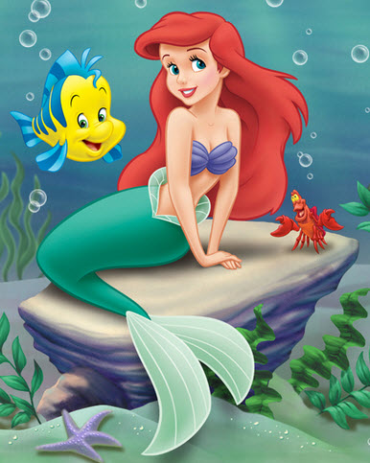
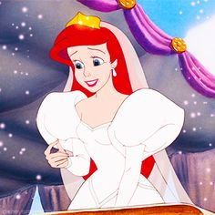
WHAT IS CHARACTER DEVELOPMENT?
Character Development
The Change a character undergoes as a result of the conflict / conflicts encountered
Dynamic characters = must have character development
Character development is product of plot events

Slide 3
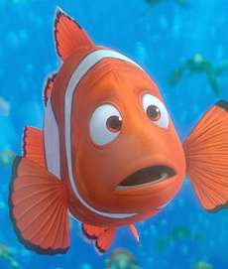
Finding Nemo
MARLIN: INITIAL
Character Development: INITIAL
What is character like at beginning of book?
Identify personality, internal conflicts, etc.
Suffering great loss (PTSD)
Overprotective
Overly smothers Nemo
Strict and uptight

Slide 4
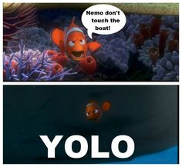
Finding Nemo
MARLIN: TRANSITIONAL - #1
Character Development: TRANSITIONAL
When does the character start to change from initial?
How does the character change from initial?
Marlin’s over protectiveness pushes Nemo to prove his ability. Marlin begins to realize that over-restricting may not always be effective.

Slide 5
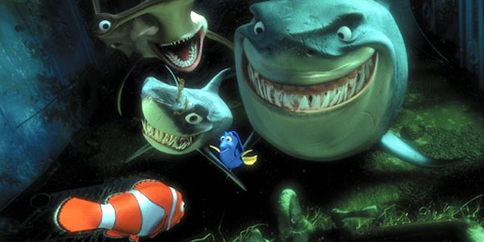
Finding Nemo
MARLIN: TRANSITIONAL - #2
Character Development: TRANSITIONAL
When does the character start to change from initial?
How does the character change from initial?
Marlin and Dory attend the “Fish Are Friends” support group meeting. Marlin begins to reconsider his immediate doubts about others based off past experiences.

Slide 6
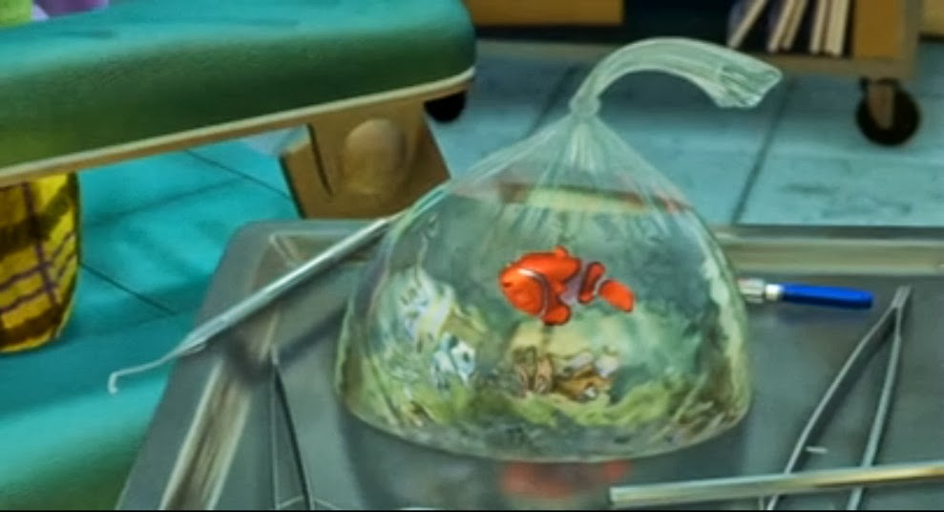
Finding Nemo
MARLIN: TRANSITIONAL - #3
Character Development: TRANSITIONAL
When does the character start to change from initial?
How does the character change from initial?
Marlin thinks Nemo is gone, causing him to be very sad. In losing his son, he regrets not letting him have fun and push his abilities before.

Slide 7
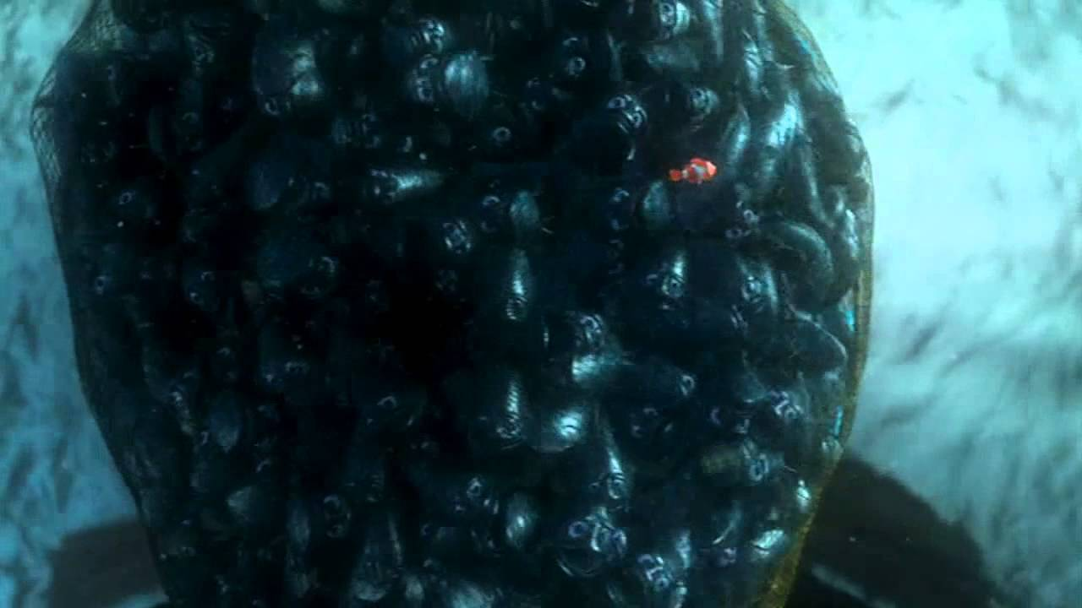
Finding Nemo
MARLIN: TRANSITIONAL - #4
Character Development: TRANSITIONAL
When does the character start to change from initial?
How does the character change from initial?
Marlin must “let go” of Nemo and trust in his knowledge and ability to motivate the fish to swim down in the net.

Slide 8
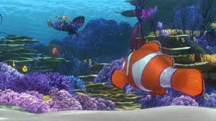
Finding Nemo
MARLIN: FINAL
Character Development: FINAL
What is the character like at the end of the novel?
Identify personality, beliefs, etc.
Becomes less protective
Trusts in Nemo
Better parent
Happier

Slide 9
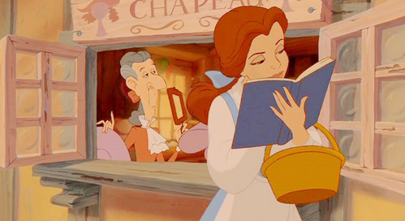
Beauty and the Beast
BELLE: INITIAL
Character Development: INITIAL
What is character like at beginning of book?
Identify personality, internal conflicts, etc.
Intelligent
Lonely
Lost in her books
Reading about adventure

Slide 10
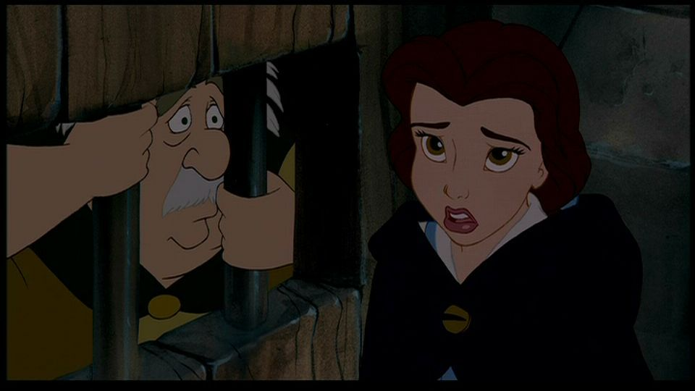
BELLE: TRANSITIONAL - #1
Beauty and the Beast
Character Development: TRANSITIONAL
When does the character start to change from initial?
How does the character change from initial?
Belle swaps places with her father, becoming beast’s prisoner. She must step out of the predictability and comfort of books to her own adventure.

Slide 11
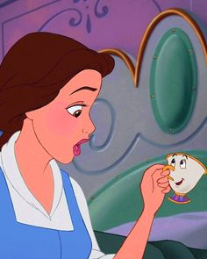
BELLE: TRANSITIONAL - #2
Beauty and the Beast
Character Development: TRANSITIONAL
When does the character start to change from initial?
How does the character change from initial?
Belle begins to believe in the supernatural when she meets the castle’s staff. She is on her own adventure and learning how magical the real world can be.

Slide 12
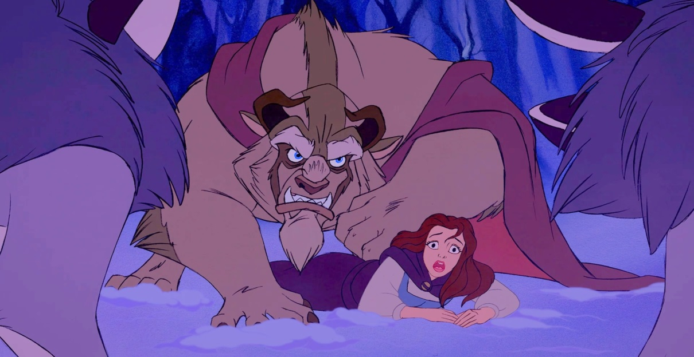
BELLE: TRANSITIONAL - #3
Beauty and the Beast
Character Development: TRANSITIONAL
When does the character start to change from initial?
How does the character change from initial?
Belle realizes the consequences of being strong minded. She realizes how important it is to have someone to care for you.

Slide 13
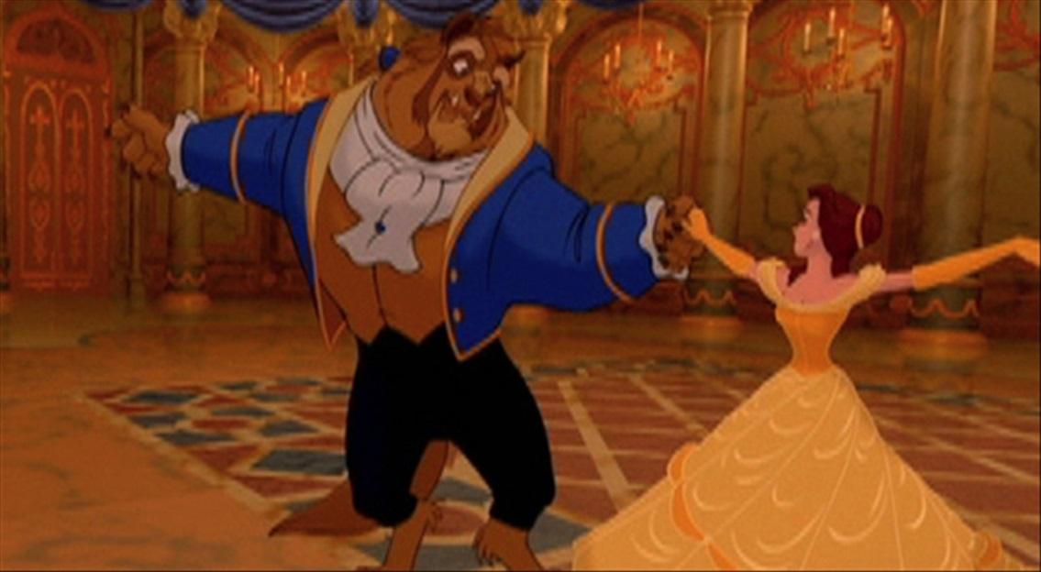
BELLE: TRANSITIONAL - #4
Beauty and the Beast
Character Development: TRANSITIONAL
When does the character start to change from initial?
How does the character change from initial?
Belle begins to fall in love with Beast. She is emotionally maturing and experiencing her own love instead of the love of romance novels.

Slide 14
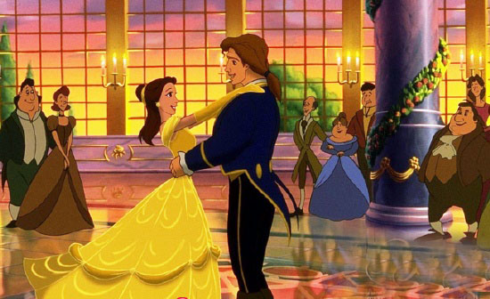
BELLE: FINAL
Beauty and the Beast
Character Development: FINAL
What is the character like at the end of the novel?
Identify personality, beliefs, etc.
Accepted
Social
Living an adventure

Slide 15
Climax
TRANSITIONAL
CHARACTER DEVELOPMENT IS CONNECTED TO PLOT POINTS!!!!!
Falling Action
TRANSITIONAL
Rising Action
TRANSITIONAL
FINAL
Resolution
Exposition
INITIAL

