Slide 1
ELEMENTS OF A STORY
Summer reading – Notes PPT

Slide 2
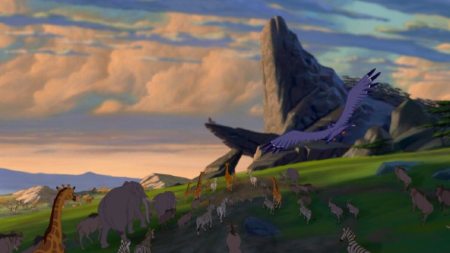
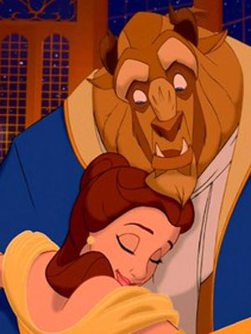
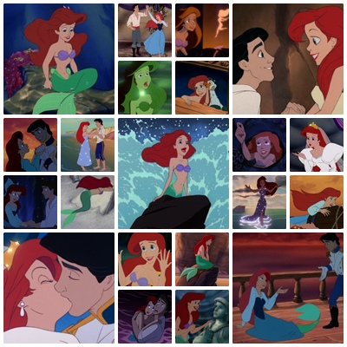
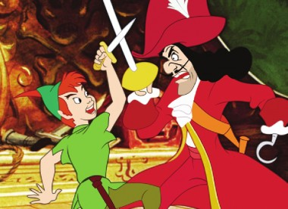
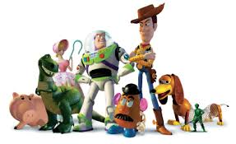
Basic Elements
SETTING
PLOT
THEME
CHARACTERS
CONFLICT

Slide 3
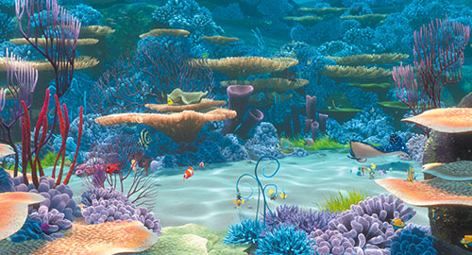
ELEMENT #1: SETTING
Setting
The time and place in which a story takes place
Physical setting = geographical location, environment, weather, etc.
Social/historical setting = time period with the social beliefs and movements of the time

Slide 4
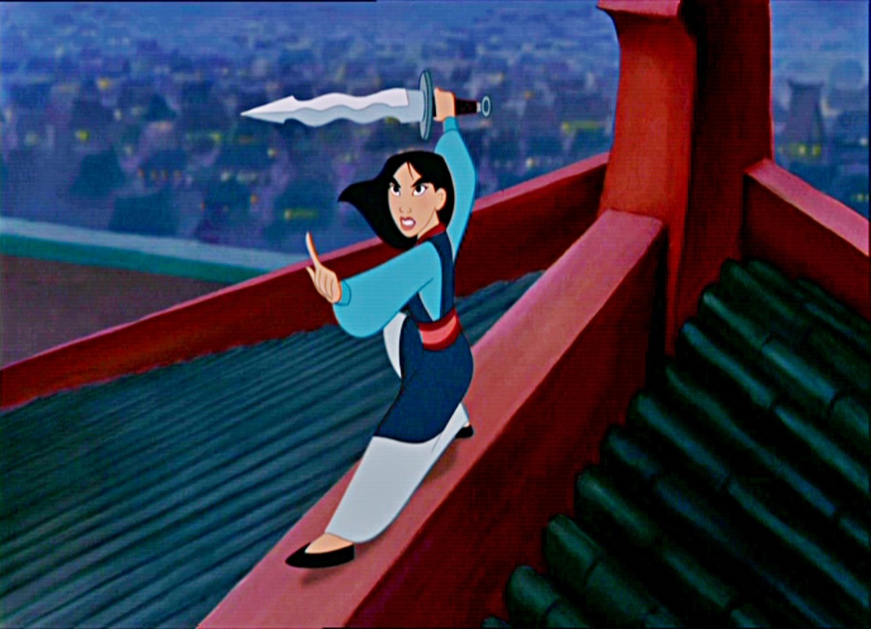
PHYSICAL
SETTING
MULAN
Time and place story takes place
Location, environment, weather, etc.
SOCIAL/HIST.
Physical → China
Social → 200BC; Han Dynasty; war with Huns; women limited rights
Time period with social beliefs and movements

Slide 5
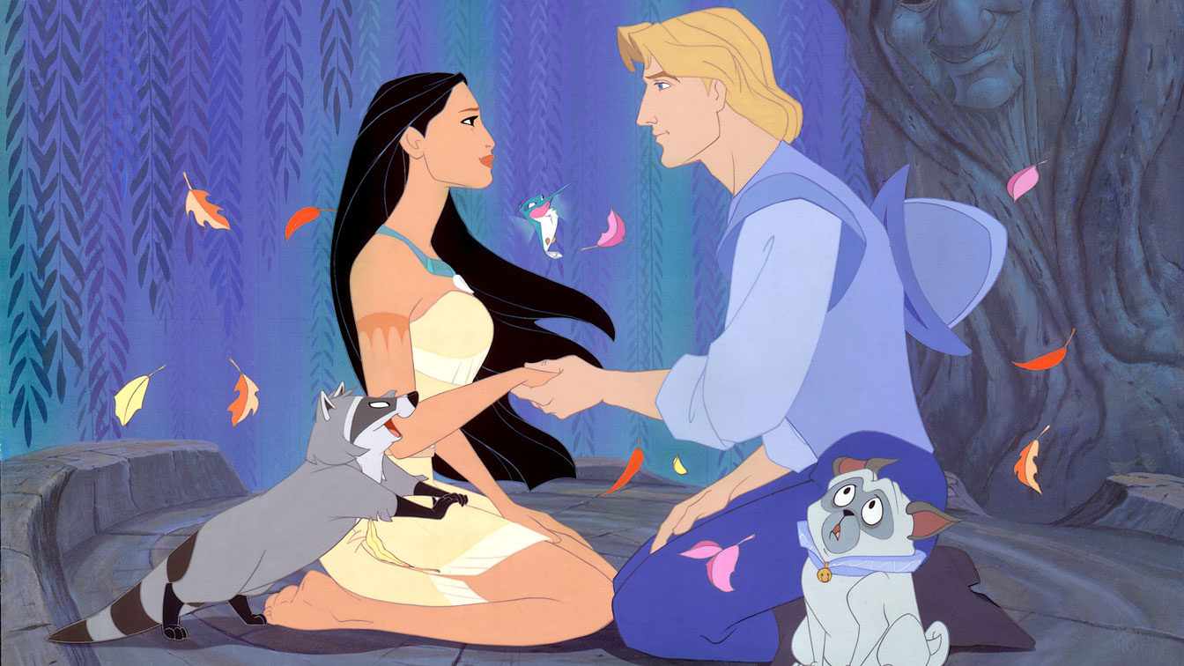
PHYSICAL
SETTING
POCAHONTAS
Time and place story takes place
Location, environment, weather, etc.
SOCIAL/HIST.
Physical → Jamestown
Social → colonization; Native American oppression
Time period with social beliefs and movements

Slide 6
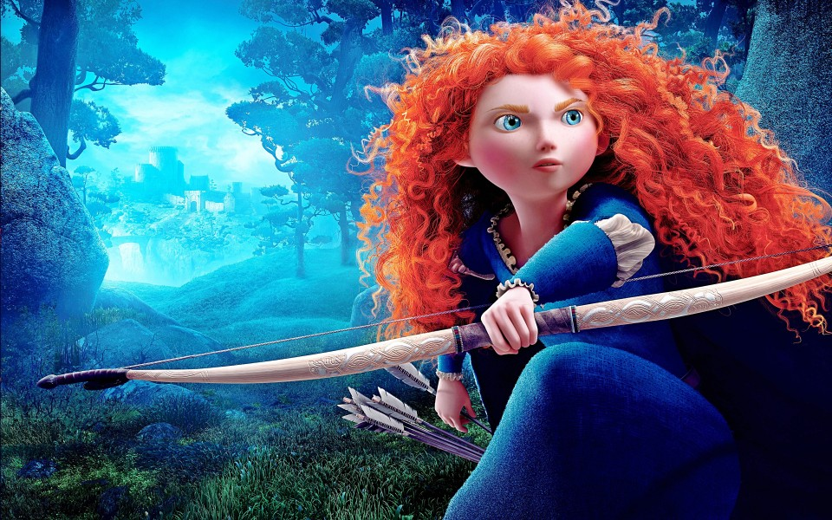
PHYSICAL
SETTING
BRAVE
Time and place story takes place
Location, environment, weather, etc.
SOCIAL/HIST.
Physical → Medieval Scotland
Social → traditional betrothal
Time period with social beliefs and movements

Slide 7
ELEMENT #2: CHARACTERS
CHARACTER
A person, animal, or figure portrayed in a story

Slide 8
ELEMENT #2: CHARACTERS
Major vs. Minor
Major = character essential to development and resolution of conflict
Minor = character who is unessential to development and resolution of conflict
Protagonist vs. Antagonist
Protagonist = leading character; “hero”
Antagonist = character in opposition to protagonist
Static vs. Dynamic
Static = character does not change; personality is the same at the beginning and at the end
Dynamic = character undergoes inner change (change in personality, attitude, beliefs, etc.)

Slide 9
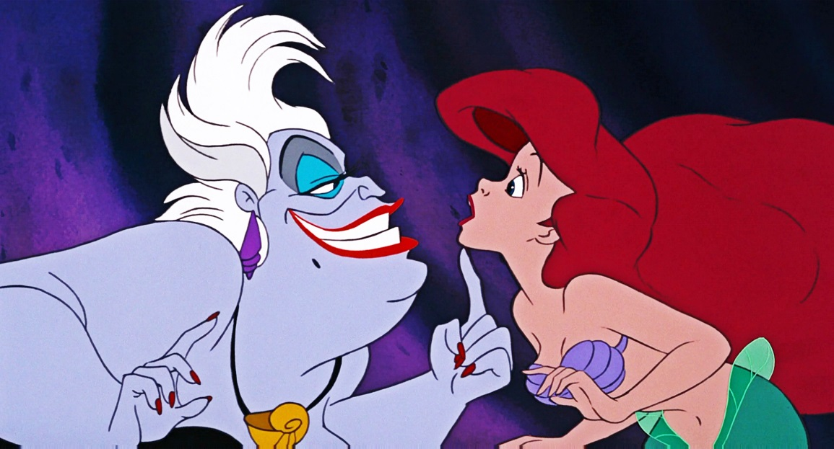
Minor vs. Major
CHARACTER
THE LITTLE MERMAID
Person, animal, or figure portrayed in a story
Protagonist vs. Antagonist
Major
Antagonist
Static
Major
Protagonist
Dynamic
Static vs. Dynamic

Slide 10
Minor vs. Major
CHARACTER
FINDING NEMO
Person, animal, or figure portrayed in a story
Protagonist vs. Antagonist
Static vs. Dynamic
Major
Static

Slide 11
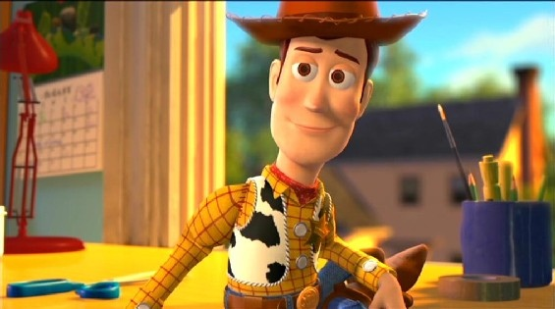
Minor vs. Major
CHARACTER
TOY STORY
Person, animal, or figure portrayed in a story
Protagonist vs. Antagonist
Protagonist
Major
Dynamic
Static vs. Dynamic

Slide 12
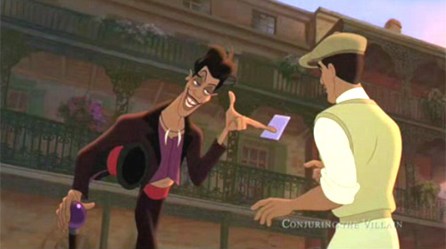
ELEMENT #3: CONFLICT
CONFLICT
Any struggle between two forces; drives the plot
One central conflict
Multiple conflicts within plot
P.P. main conflict = Hook
P.P. multi. conflicts = battle with Indians, Tinkerbell’s jealousy, losing shadow, etc.

Slide 13
ELEMENT #3: CONFLICT
Man vs. Man
Opposing desires, interests, etc. b/w two characters
Typically between protagonists and antagonist
Man vs. Self
Internal struggle of protagonist (i.e. decide between good & evil, overcome self-doubts)
External forces prompt internal changes
Man vs. Nature
Opposition from natural forces (i.e. storm, tornado)

Slide 14
ELEMENT #3: CONFLICT
Man vs. Society
Struggle between man and social norms of society
Man vs. Technology
Struggle between man and manmade machines
Man vs. Fate
Struggle against protagonist and what has been pre-determined for that person

Slide 15
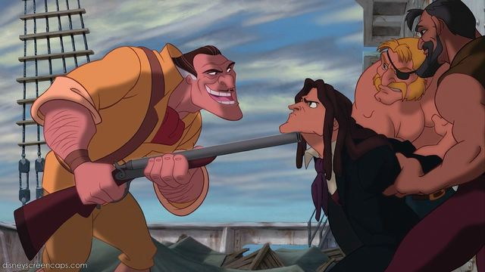
Man vs. Man Man vs. Self Man vs. Nature Man vs. Society Man vs. Tech. Man vs. Fate
CONFLICT
TARZAN
Struggle between two forces
Main: Man vs. Society
Minor: Man. vs. Nature
Minor: Man vs. Man

Slide 16
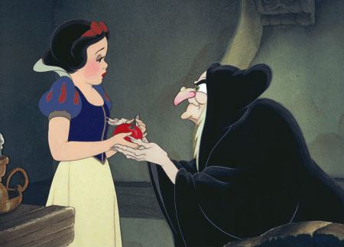
Man vs. Man Man vs. Self Man vs. Nature Man vs. Society Man vs. Tech. Man vs. Fate
CONFLICT
SNOW WHITE
Struggle between two forces
Main: Man vs. Man
Minor: Man. vs. Nature

Slide 17
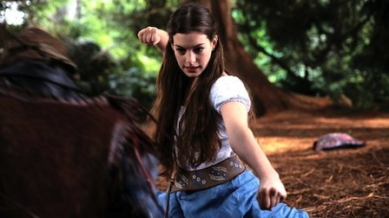
Man vs. Man Man vs. Self Man vs. Nature Man vs. Society Man vs. Tech. Man vs. Fate
CONFLICT
ELLA ENCHANTED
Struggle between two forces
Main: Man vs. Fate
Minor: Man. Vs. Man

Slide 18
ELEMENT #4: PLOT
PLOT
Events that make
up story
Sequenced
Related to one another
Driven by main conflict

Slide 19
ELEMENT #4: PLOT
Last possible moment where outcome could be different
Conflict reaches highest point; most important/ exciting part
Climax
Events building and increasing conflict
Events decreasing conflict
Falling Action
Rising Action
Conflict outcome is decided; all loose ends tied
Resolution
Exposition
Character, setting, background intro

Slide 20
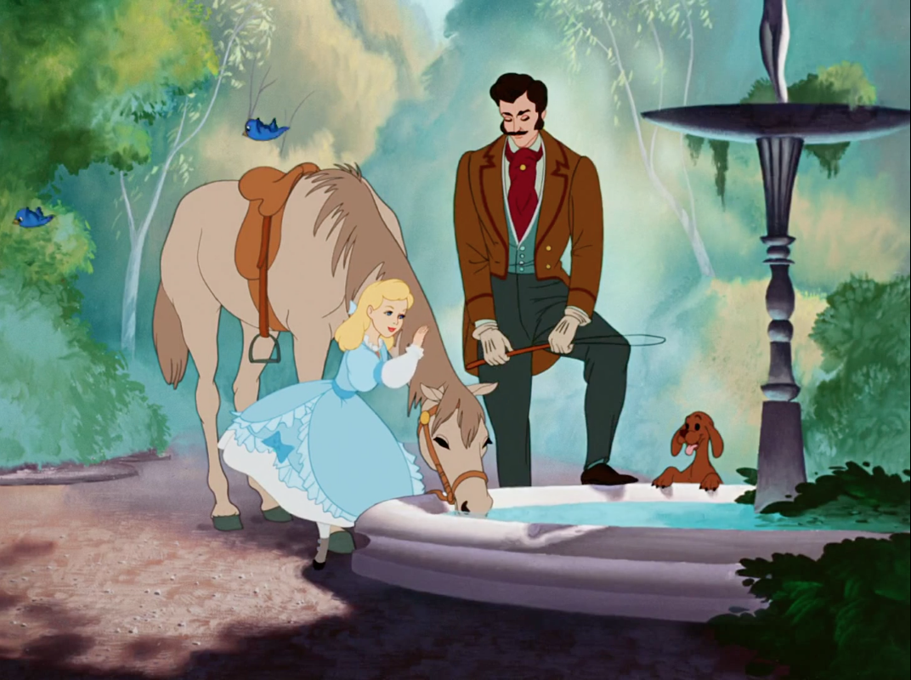
Exposition rising action climax falling action resolution
PLOT
CINDERELLA
Events that make up story
EXPOSITION

Slide 21
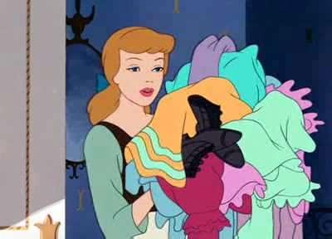
Exposition rising action climax falling action resolution
PLOT
CINDERELLA
Events that make up story
RISING ACTION

Slide 22
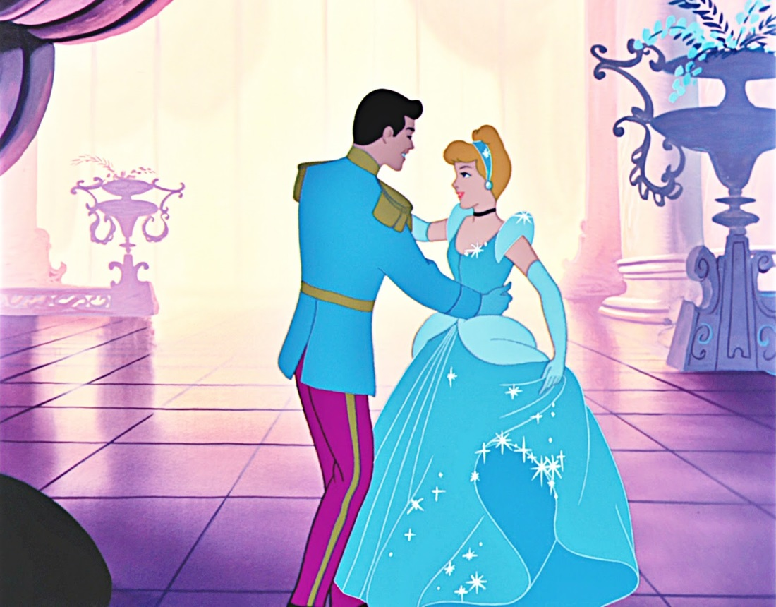
Exposition rising action climax falling action resolution
PLOT
CINDERELLA
Events that make up story
RISING ACTION

Slide 23
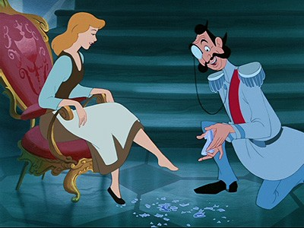
Exposition rising action climax falling action resolution
PLOT
CINDERELLA
Events that make up story
CLIMAX

Slide 24
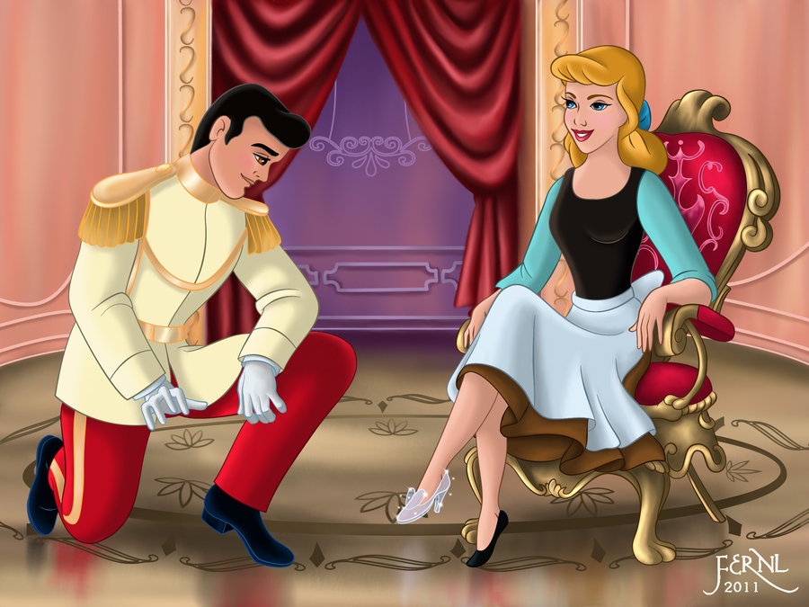
Exposition rising action climax falling action resolution
PLOT
CINDERELLA
Events that make up story
Falling Action

Slide 25
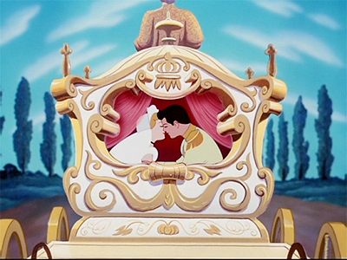
Exposition rising action climax falling action resolution
PLOT
CINDERELLA
Events that make up story
Resolution

Slide 26
ELEMENT #5: THEME
THEME
Main idea or underlying meaning in a text
Major theme = repeated throughout text
Minor theme = less present; contributes to major theme

Slide 27
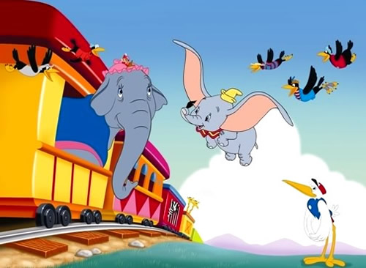
Major theme = present throughout the text Minor theme = less present; contributes to main theme
THEME
DUMBO
Main idea; underlying message
Put yourself in another’s shoes.
Believe in yourself.

Slide 28
Major theme = present throughout the text Minor theme = less present; contributes to main theme
THEME
BEAUTY AND THE BEAST
Main idea; underlying message
Don’t judge a book by its cover.

Slide 29
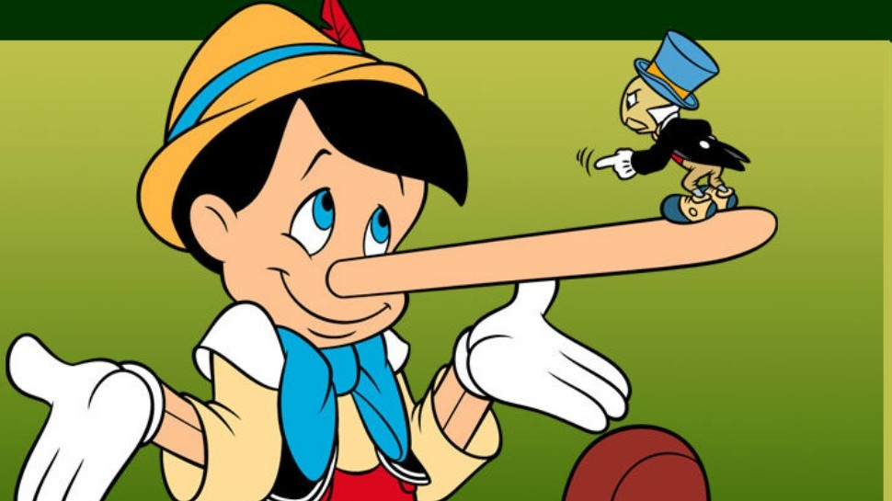
THEME
PINOCCHIO
Main idea; underlying message
Major theme = present throughout the text Minor theme = less present; contributes to main theme
Choose good over evil.
Be honest.

