Slide 1
MODES OF PERSUASION
Writing workshop #3

Slide 2
THREE MODES
LOGOS
PATHOS
ETHOS
SWEET
SPOT
LOGIC
EMOTION
CREDIBILITY

Slide 3
MODES OF PERSUASION:
Persuasion is clearly a sort of demonstration, since we are most fully persuaded when we consider a thing to have been demonstrated.
Of the modes of persuasion furnished by the spoken word there are three kinds.
Persuasion is achieved by the speaker's personal character when the speech is so spoken as to make us think him credible.
Secondly, persuasion may come through the hearers, when the speech stirs their emotions.
Thirdly, persuasion is effected through the speech itself when we have proved a truth or an apparent truth by means of the persuasive arguments suitable to the case in question.
---- ARISTOTLE, "Rhetoric", 350 BCE
ORIGIN

Slide 4
LOGOS
LOGOS
Logos → appeal to logic; convince
audience by using logic or
reason
Cite facts
Cite statistics
Historical or literal analogies
Citing authorities
Content area language
LOGIC

Slide 5
LOGOS: EXAMPLES
“It’s a matter of common sense that people deserve to be treated equally. The Constitution calls it “self-evident.”
“Research compiled by analysts from NASA suggest that a moon colony is viable with international support.”
“History has shown time and again that absolute power corrupts absolutely.”
“In 25 years of driving the same route, I haven’t seen a single deer.”

Slide 6
PATHOS
PATHOS
Pathos → appeal to emotions; convince
audience by creating an
emotional reaction
Invoke sympathy
Draw pity
Inspire anger
Meaningful language
Emotional tone
Emotional stories
EMOTION

Slide 7
PATHOS: EXAMPLES
“Love, it’s what makes a Subaru a Subaru.”
Food ads showing families having a good time around the table
Sarah McLacklan’s song “Arms of an Angel” playing on animal abuse commercials
“Can’t you see how dangerous it would be to stay?”
“Don’t be the last person on the block to have their lawn treated. You don’t want to be the laughing stock of your community!”
“Better men than us have fought and died to preserve this great nation. Now is our turn to return the favor.”

Slide 8
ETHOS
ETHOS
Ethos → appeal to ethics; convince
audience by establishing the
author’s credibility
Appropriate vocabulary
Correct grammar and syntax
Make self sound unbiased
Introducing expertise
Master of knowledge
Connect to audience
CREDIBILITY

Slide 9
ETHOS: EXAMPLES
“Trust me, I’m a doctor.”
“With my two decades of experience as a dance teacher, you can believe what I’m talking about.”
“You know me – I’ve babysat your children, served as a playground director, and taught Sunday school.”
“If my age doesn’t convince you of my wisdom, consider that I am your grandfather, and I love you dearly.”
“4 out of 5 dentists agree.”

Slide 10
A soft instrumental symphony plays in the background of a commercial asking for donations.
LOGOS
PATHOS
ETHOS

Slide 11
Fair trade agreements have raised the quality of life for coffee producers, so fair trade agreements could be used to help other farmers as well.
LOGOS
PATHOS
ETHOS

Slide 12
“And so even though we face the difficulties of today and tomorrow, I still have a dream. It is a dream deeply rooted in the American dream.”
LOGOS
PATHOS
ETHOS

Slide 13
“Our expertise in roofing contracting is evidenced in the decades of satisfied customers who have come to expect nothing but the best.”
LOGOS
PATHOS
ETHOS

Slide 14
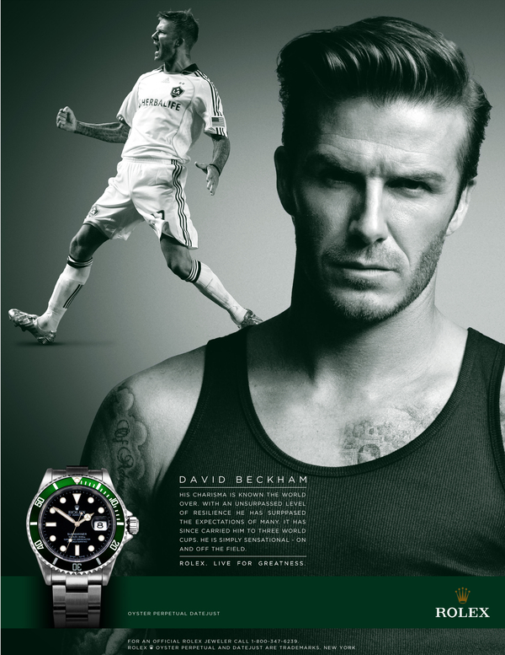
LOGOS
PATHOS
ETHOS

Slide 15
LOGOS
PATHOS
ETHOS

Slide 16
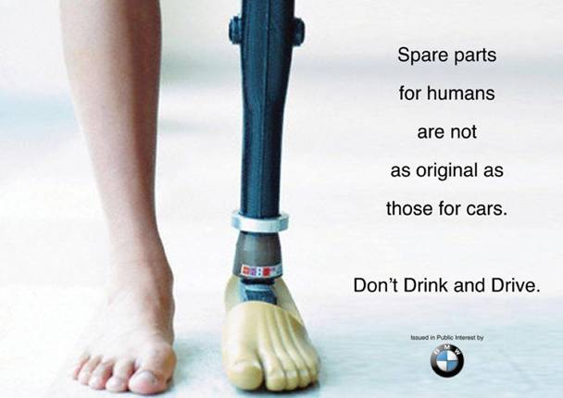
LOGOS
PATHOS
ETHOS

Slide 17
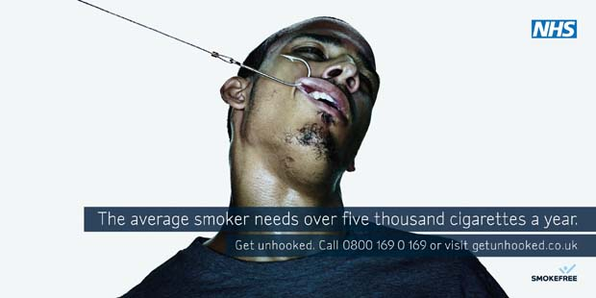
LOGOS
PATHOS
ETHOS

Slide 18
All men are mortal.
Socrates is a man.
Therefore, Socrates is mortal.
LOGOS
PATHOS
ETHOS

Slide 19
“If his years as a soldier taught him anything, it’s that caution is the best policy in this sort of situation.”
LOGOS
PATHOS
ETHOS

